Slide 1
Simple randomized controlled experiment aka A B Testing
Gokul Packirisamy

Slide 2
Table of content
Introduction
AB in plain English
Steps involved
Pros and cons
Usage

Slide 3

Introduction
An FMCG company wants to check the customer reaction before and after splitting a product into two category, conducting an A/B testing will statistically prove which provides better customer satisfaction.
A/B testing is statistically
comparing
the multiple versions of
one variable.

Slide 4
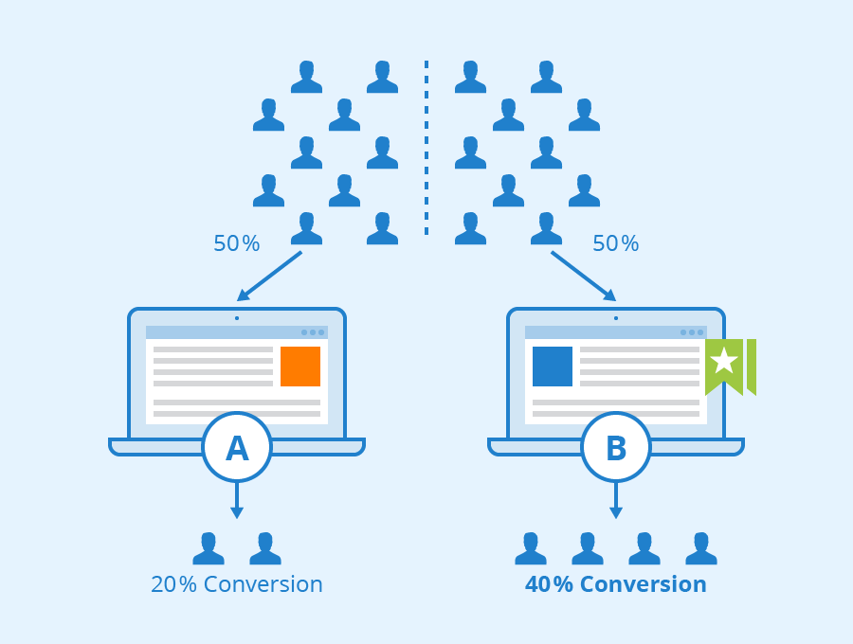
A/B testing in plain English
In an A/B test, Statisticians/researchers select two versions A and B which needs to be compared.
Same number of sample is selected from two versions.
Data is collected through experiment conducted at two versions.
When the test is done, which ever version gives higher statistical success rate is considered as the better version.
When the statistician conclude that one of the version is more likely the successful than the other, A/B test is concluded.

Slide 5
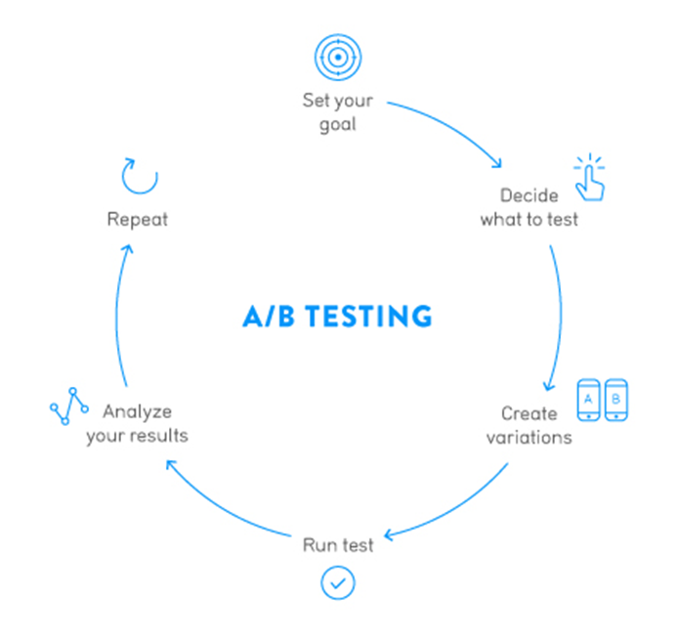
Steps involved
Finding issues or the problem.
Decision on which variable to track.
building a hypothesis.
Building versions.
Determine the sample size.
Conducting the A/B test.
Working on the A/B test results.

Slide 6
Pros Cons
Helps to get clear evidence of any decision made
Enables test all new ideas implemented
Enables optimization by one step at a time
Answers any questions based on design
Time and resources used are high for each decision
Only specific goals are accomplished.
Doesn’t solve underlying issue
Might lead to the requirement of periodical testings.

Slide 7

Usage
Compares the performance of two versions of any product/material to see which one is relatively good.
Optimize marketing campaigns.
Improve user interface and user experience of websites.
Increase customers turnout ratio.
Increase product sales by adding features
To decide on increasing the transaction of individual users in banks.

Slide 8
Thank you

